Slide 1



Super Store Sales Analysis
Dr. Doaa Sayed

Slide 2




Project analysis slide 3
Meet The Team
Mohamed Jamal
Amr Mohamed
Mazen Maher
Mostafa Amin
Python Developer & Data Analyst
Muhammad was responsible for data cleaning and visualization using Python, as well as performing in-depth data analysis.
Python Developer & Data Analyst
Amr was responsible for data cleaning and visualization using Python, focusing on preparing data for analysis.
Power BI Specialist & Data Analyst
Mazen is responsible for data visualization, contributing through detailed dashboards using Power BI.
Power BI Specialist & Data Analyst
Mostafa specializes in crafting interactive dashboards using Power BI, delivering compelling visualizations for data insights.

Slide 3

Project analysis slide 3
Meet The Team
Team Roles
In General
Our team worked cohesively on the data analysis project by holding regular meetings to set project goals and review available data. Each step in the analysis process was the result of discussions and collaborative efforts among team members. During the meetings, tasks were distributed based on each member's skills, including report preparation, development of visualizations, and presentation of final recommendations. The results of the project were the product of collective efforts that relied on the summaries from those meetings.

Slide 4
Project analysis slide 4
Introduction
Welcome to our data analysis presentation, where we explore key insights derived from the given dataset. The project focuses on analyzing sales performance, unit pricing, gross margin, and product-specific trends. Our goal is to uncover actionable insights that drive better decision-making and improve overall business outcomes. Through in-depth analysis and detailed visualizations, we aim to provide recommendations to enhance sales strategies and optimize operations."
Tasks
Schedules
Resources

Slide 5




Project analysis slide 2
Data Analysis Steps
Reporting
Data Collection
PROJECT
Steps
Visualization
Data Exploration
Data Analysis
Data Cleaning

Slide 6
Project analysis slide 4
Data Exploration
Tasks
Data Exploration :In this phase of the project, the dataset was explored to assess its alignment with the analysis goals. The data was reviewed and examined to understand the characteristics of various columns, such as products, customers, and sales.
Schedules
Resources

Slide 7
Project analysis slide 4
Data Exploration
After exploring the data and conducting an analysis, we identified the fact table and the dimension tables within the Star Schema. Based on the typical structure of a Star Schema used in data analysis, the setup can be described as follows:
Tasks
Star Schema Overview :
Fact Table :
Orders Table: Contains transactional data, including Order ID, revenue, and order dates.
Dimension Tables:
Customers Table: Details about customers (name, ID).
Products Table: Information on products (name, category, price).
Categories Table: Product categories (beverages, condiments, etc.).
Employees Table: Data on employees processing orders.
Suppliers Table: Information about suppliers.
Order Details Table: Additional order info (quantity, price per unit).
Schedules
Resources

Slide 8
Project analysis slide 4
Data Cleaning
Data Cleaning Overview:
Data cleaning is a crucial step in the data preparation process. It involves identifying and correcting inaccuracies, handling missing values, and ensuring the dataset is consistent and reliable. Without proper cleaning, the analysis can lead to misleading or incorrect conclusions, as models or visualizations may be affected by faulty data.
Tasks
Why It's Important for This Project:
In this project, cleaning the dataset ensures:
Improved Data Quality: Removing missing or irrelevant values helps avoid biases or incorrect results.
Informed Decision Making: Clean data leads to more accurate insights, enabling better decision-making based on trustworthy analysis.
Steps in Cleaning:
Removed duplicates and null values.
Standardized formats for dates and addresses.
Corrected inconsistencies in data
Schedules
Resources

Slide 9
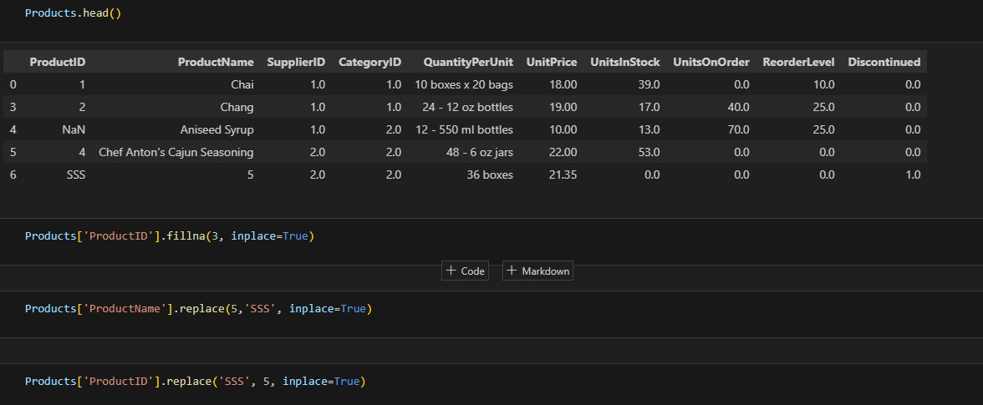
Project analysis slide 5
Data Cleaning
Filled missing values in the "ProductID" column.
Replaced incorrect entries like 'SSS' in the "ProductName" column.
Ensured all data is consistent and ready for analysis.

Slide 10
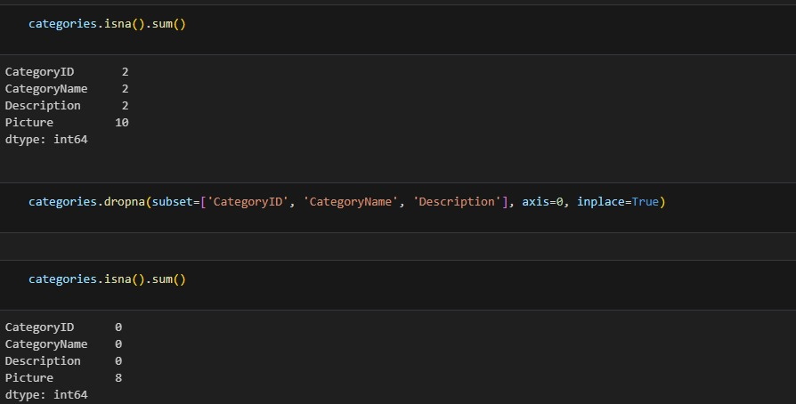
Project analysis slide 5
Data Cleaning
Initial check showed missing values in several columns such as "CategoryID," "CategoryName," and "Description."
Applied the dropna() function to remove rows with missing values in these key columns.
Rechecked for missing values, confirming the data was cleaned.

Slide 11

Project analysis slide 4
Data Analysis
In this phase, a comprehensive analysis of all aspects of the data was conducted to provide deep insights into sales, customers, and shipping. The analysis covered the following:
Sales Analysis:
From our sales analysis, we discovered the total sales figures and
the sales performance for each country and product category.
This information helps us understand which countries and categories generate the most revenue, guiding our decisions on inventory management and marketing strategies.
Supplier Analysis:
Supplier Performance: Assessed based on product availability and quality, identifying the most reliable suppliers.
Best Performing Suppliers: Highlighted those with the highest sales and lowest return rates, indicating strong demand.
Employee Analysis:
Performance Evaluation: Assessed each employee's contribution to sales
Order Count: Identified the number of orders handled by each employee, spotlighting top performers.
Customer Engagement: Analyzed the clients each employee worked with to evaluate relationship management.
Targets Assessment: Compared employee performance against established targets to highlight achievers and those needing assistance.
Country Analysis:
Sales Distribution: Identified countries with the highest revenue, highlighting key markets.
Top Companies: Evaluated the best-performing suppliers in each country to understand their impact on sales.
Customer Count: Analyzed the number of customers per country to gauge market reach.
Order Volume: Examined total orders from each country to reveal purchasing patterns.

Slide 12
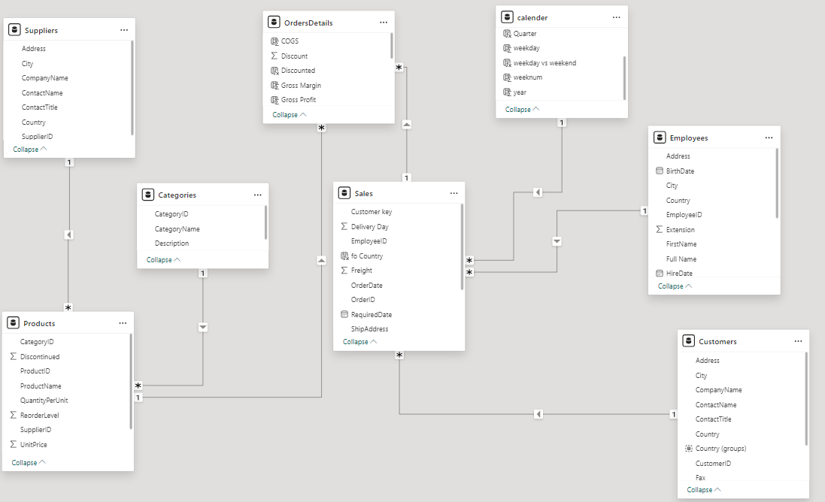
Project analysis slide 4
Star Schema
Tasks
Schedules
Resources

Slide 13
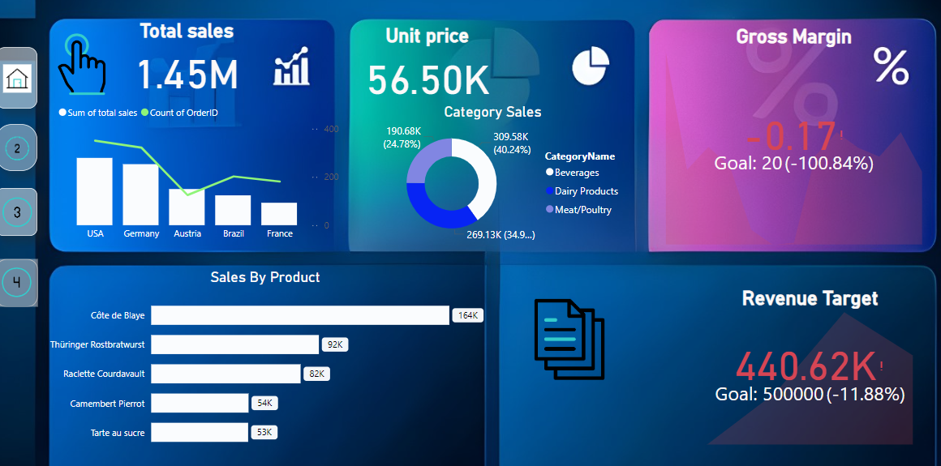
Project analysis slide 4
Visualization
Tasks
Schedules
Resources

Slide 14
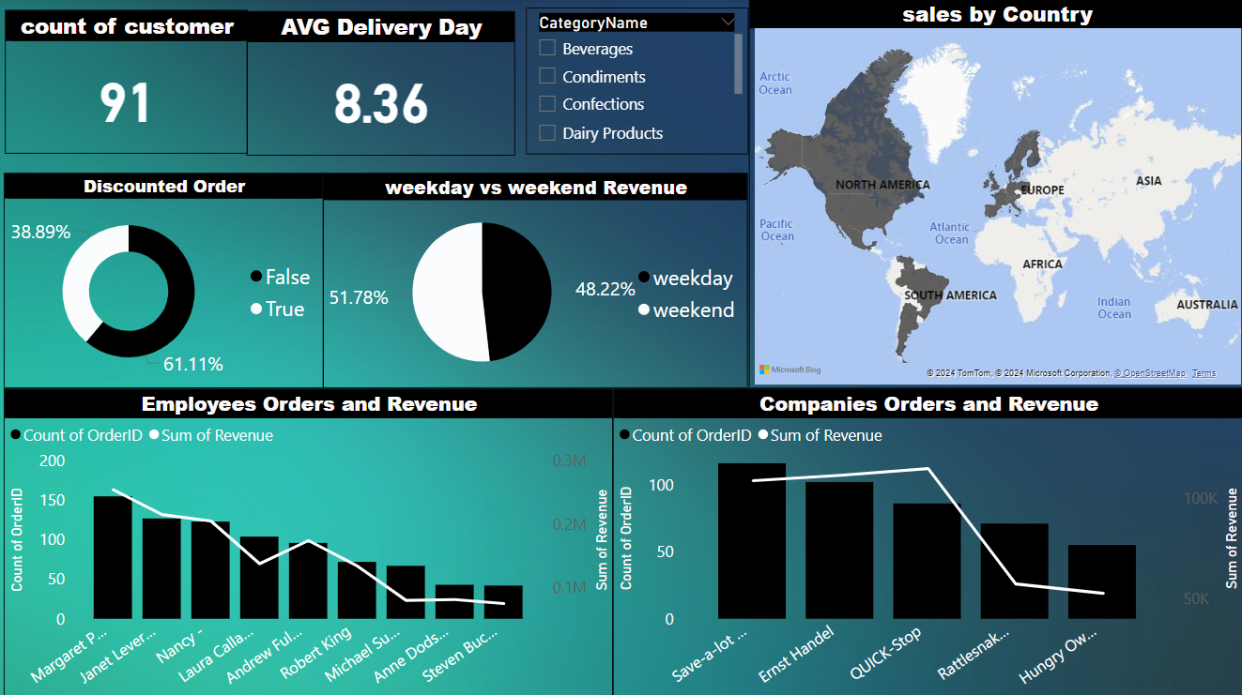
Project analysis slide 4
Visualization
Tasks
Schedules
Resources

Slide 15
Project analysis slide 4
Reporting
Tasks
We have extracted key decisions to enhance sales based on the insights derived from the data. These decisions are detailed in the comprehensive report.
Schedules
Resources

Slide 16
Project analysis slide 4
Project Objective
Tasks
1.Primary Objective:
To analyze sales data and provide insights into key factors influencing sales performance, unit pricing, and gross margin across different regions and product categories.
2. Specific Goals:
Identify the top-selling products and regions driving the highest revenue.
Analyze the impact of pricing strategies on gross margin performance.
Compare monthly sales against targets to assess seasonal trends and performance.
Provide recommendations to optimize product sales and regional performance.
3. Scope of the Analysis:
This analysis covers sales data across various regions, product categories, and time periods, focusing on unit price, sales volume, and gross margin.
Schedules
Resources

Slide 17
Project analysis slide 4
Conclusion
Tasks
The data analysis project has successfully provided actionable insights into sales performance, product categories, and regional trends. Through thorough data cleaning and exploration, the team identified key patterns that influence revenue, customer engagement, and supplier performance.
Key findings include:
Top Products and Regions: The analysis pinpointed the most profitable products and regions, enabling better inventory and marketing decisions.
Employee and Supplier Evaluation: Detailed evaluations of employee contributions and supplier reliability offer strategic opportunities to improve operational efficiency.
Sales Trends: The discovery of seasonal sales patterns allows for better future planning and forecasting.
These insights form the foundation for future decision-making, helping optimize pricing strategies, focus on high-performing regions, and streamline operations across the company.
Schedules
Resources
Our Website

Slide 18
Thank You

